Slide 1
Testing, Evaluation and Research Services
Andrew Ura
Manager, Testing and Assessment.
Notes:
Orientation Presentation for Parents Orientation
Good _______ everyone, my name is Andrew Ura, I am the Manager of Testing, Evaluation and Research Services, here at Wayne State. I am here to briefly introduce my office to you, answer a few general questions if you have any, and if you have any specific questions I will be happy to answer them after I have given my presentation.
https://tinyurl.com/WSUparents

Slide 2
Contact Testing
Web Site testing.wayne.edu
Phone Number (313) 577-3400
Email testing@wayne.edu
Notes:
Everything I am about to tell you can be found on our website, testing .wayne.edu. (home_page). We do encourage visits to the page, and if your student has any questions they can call us at 577-3400, option 3, or send an email to testing@wayne.edu

Slide 3
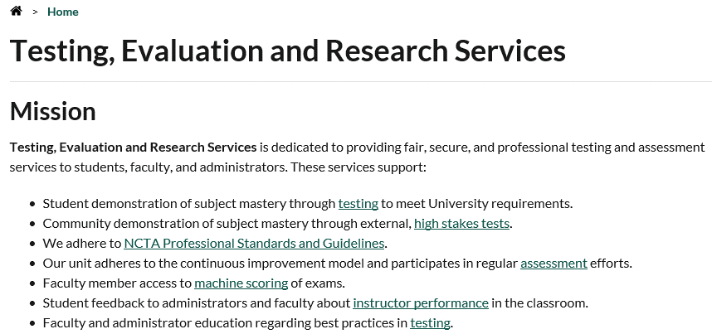
Notes:
The mission of the Wayne State Testing Office is
Dedicated to fair and accurate testing and evaluation.
Certified NCTA center

Slide 4
Testing, Evaluation and Research Services
We help administrators to learn what types of students attend Wayne, so that they can make the university a better place for them.
Research Services
1
We help students gain an inside track to best faculty.
We help good faculty be rewarded by higher pay and promotions.
Evaluation
2
We help students have equal opportunity to prove that they are ready for harder classes, graduate school, and the option of meeting a requirement by taking a test instead of a course.
Testing
3
Notes:
We have three essential responsibilities for the University. Testing, Evaluation, Research Services.

Slide 5
Testing, Evaluation and Research Services
We help administrators to learn what types of students attend Wayne, so that they can make the university a better place for them.
Research Services
1
Notes:
Research Services are services offered to our instructors and departments, we do computer scoring of instructors multiple choice exams, and we administer various other surveys for instructors and departments.
We help the university to understand what happens in the university.

Slide 6
Cooperative Institutional Research Program (CIRP) Freshman Survey
CIRP is a survey to help students share important information about themselves confidentially with administrators.
It helps us to understand what our students need, so we can change and grow appropriately.
Notes:
As part of this effort your kids will be asked today to complete a survey called
Cooperative Institutional Research Program Freshman Survey (CIRP).
This is a very comprehensive survey instrument that is used nationally and here at Wayne.
The goal of the study nationally is to track how public opinion changes over time.
We have recently found that the incoming students are more tech savvy and artistic than in past years.
We also learn about touchier issues like drinking, studying, personal habits and finances.
This information is not used on an individual level.
Instead it is used to create a snapshot of our students in general.
It’s used to determine programming.
Survey is confidential.
Survey is not anonymous, Students are asked to put their and student ID number on the survey for verification that only students who enrolled data is used in our reports. The address is used for further verification in the case of poor handwriting or similar names.
Students are encouraged but not required to complete the survey, and if they are unable to answer or wish to skip certain questions on the survey they can certainly do so.
We have in the past gotten calls from parents concerned about the nature of the questions, some of them do get personal and maybe questions that your kids can’t or don’t wish to answer.
If you have questions, feel free to contact us.

Slide 7
Testing, Evaluation and Research Services
We help good faculty be rewarded by higher pay and promotions.
We help students gain an inside track to best faculty.
Evaluation
2
Notes:
Teachers give evaluations during the semester.
This is the students’ chance to evaluate their instructors.
Evaluation, refers primarily to the Student Evaluation of Teaching program, SET. At the end of each semester, students get to evaluate their courses and instructors.
These evaluations are used by the University and departments in hiring and tenure decisions
Instructors care about what is written and use it to improve their teaching.

Slide 8
Student Evaluation
Please encourage your students to participate! Student opinions matter.
Please encourage your students to click on the faculty member’s name in the schedule of classes. This links to a SET report for that instructor.
http://set.wayne.edu
Notes:
The evaluations are also a benefit to the students because the results are made available to students to help them make decisions in picking their instructors.
Students may view the instructors results.
This can help students pick instructors when more than one instructor is offering a class.

Slide 9
Find your instructor’s SET results
Notes:
Follow the links under evaluation on our website
Through our web site students can search by either subject, or instructor name and see the instructors results.
Select subject give you a list of courses, select the course
Enter the course or instructors’ name to see the results.

Slide 10
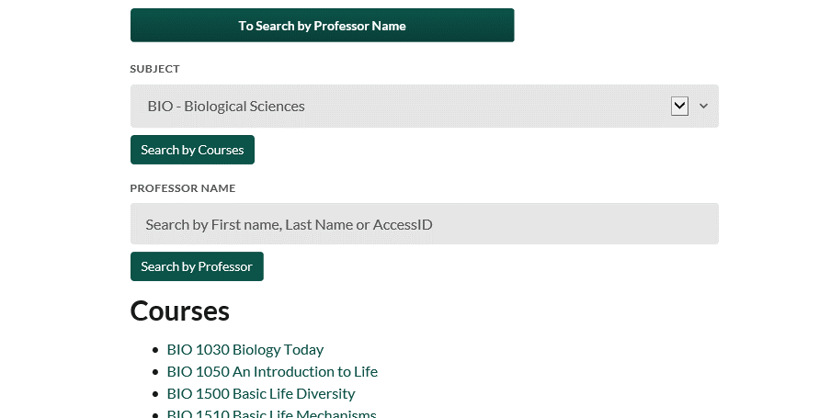

Slide 11
Notes:
Get list of instructors.
Select one of these.

Slide 12
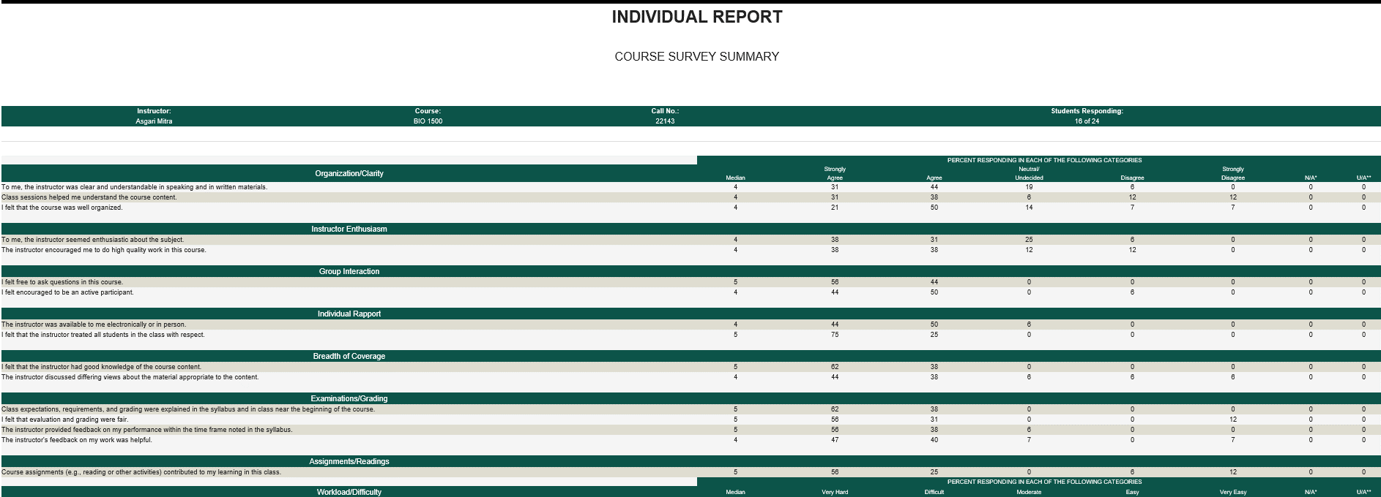
Notes:
See instructors’ results

Slide 13
Testing, Evaluation and Research Services
1
We help students have equal opportunity to prove that they are ready for harder classes, graduate school, and the option of meeting a requirement by taking a test instead of a course.
Testing
3
2
Notes:
Testing.
Since your kids are here today, they most likely have had at least some contact with our office since they are encouraged to take their placement exams prior to orientation since they are used to determine what courses they can register for.

Slide 14
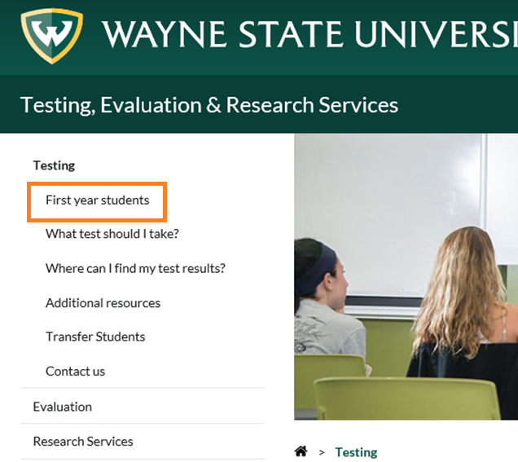
Notes:
On the front page of our site,
the first link is for First Year Students, this page is dedicated to your students, the incoming class, and address the four Placement Exams, which are;
Biology,
Chemistry,
English
and Math.

Slide 15
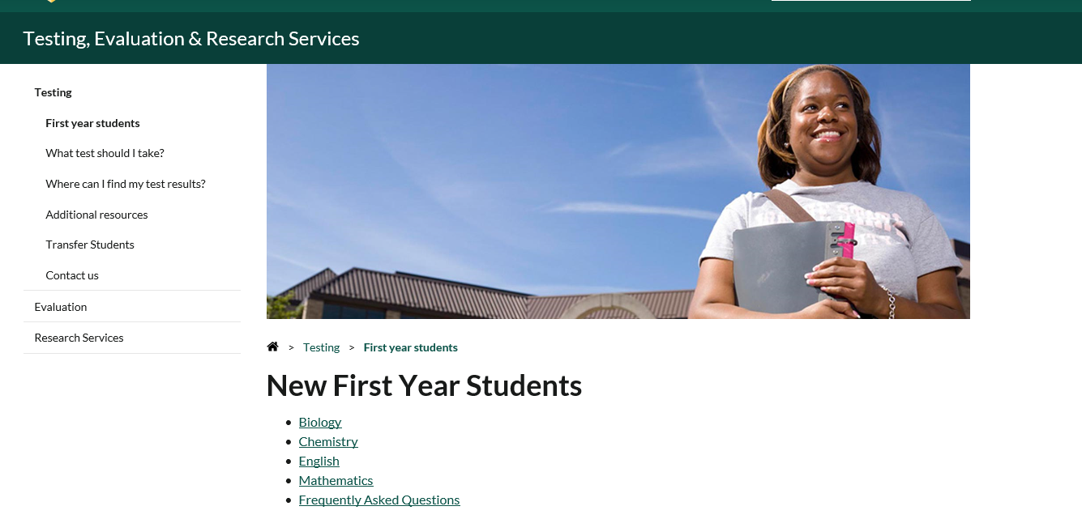
Notes:
All four exams are addressed in detail, and have the schedule of test dates and registration directions.

Slide 16
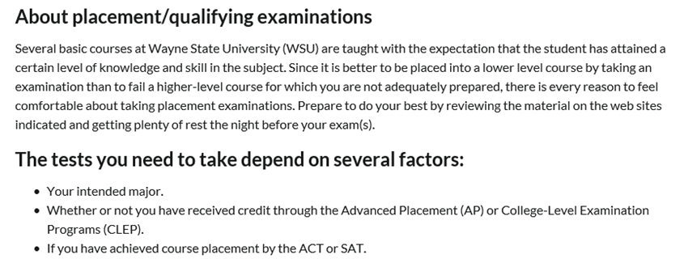
Notes:
Before you get to that you need to know the basic philosophy about placement tests;
There are some courses that require a foundation of knowledge.
We consider that it is better to take a lower level course and be successful, rather than to take a course you are unprepared for.
There is every reason to consider that you the placement you earn is the best course for you to take.

Slide 17
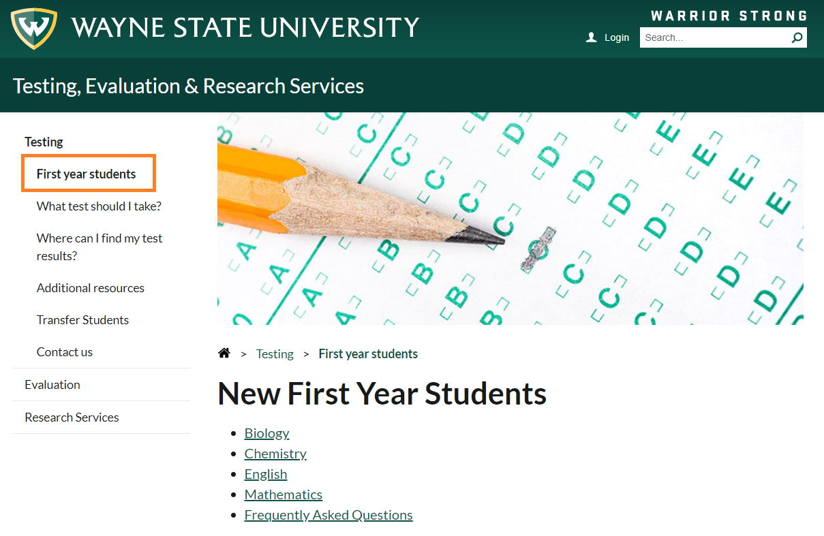
https://testing.wayne.edu/testing/first-year-students
Notes:
And which tests to take
ACT/SAT scores
Chemistry no ACT/SAT
General Notes
SDS
Register button at bottom
What Test Should I Take?
CLEP
National Testing Companies

Slide 18
Test registration
Notes:
Once you have decided what exams to take,
Registration is done online through the website.
You can also change your test dates through the website.
If your student has registered for a test, and needs to change that, there is a process for refunds.
Once your student is registered, they receive an email confirmation.
It tells them where and when to go.
What to bring
If there are any study aids available.

Slide 19
https://studentdisability.wayne.edu/
Notes:
If your student requires accommodations, that is done through SDS.
There is a link from our website.

Slide 20
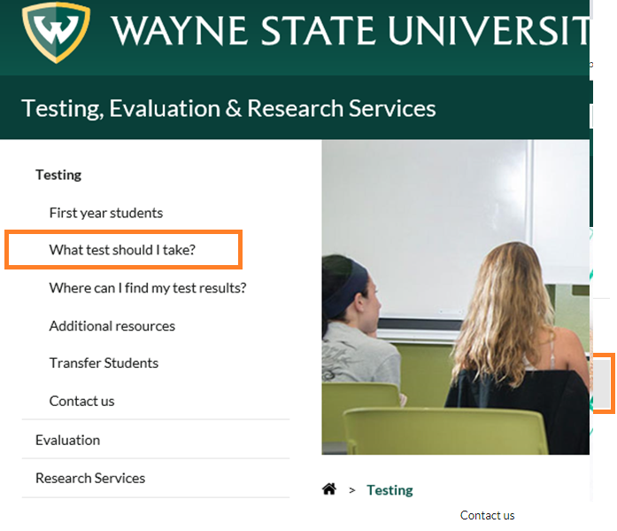
Notes:
Testing might occur during later in student academic careers.
You may find this information under “what test should I take”

Slide 21
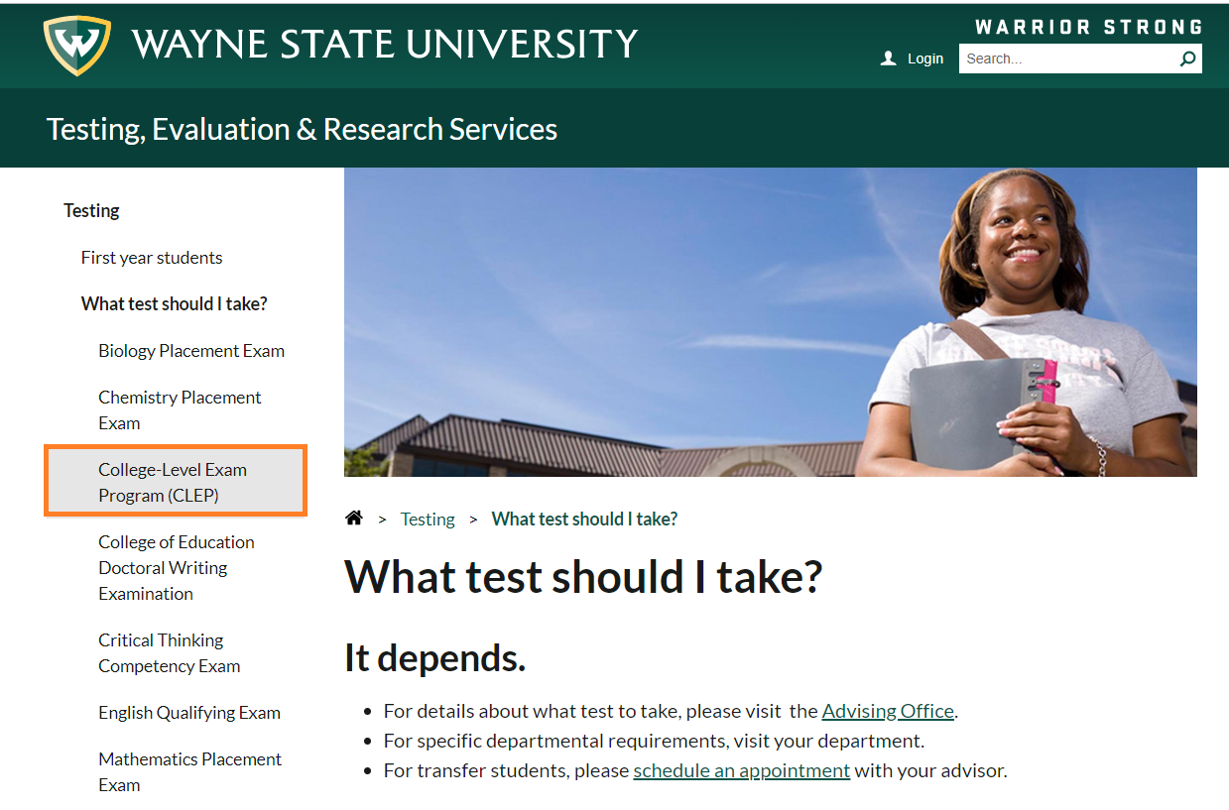
Notes:
This page lists all the tests we administer.
1. College level exam program

Slide 22
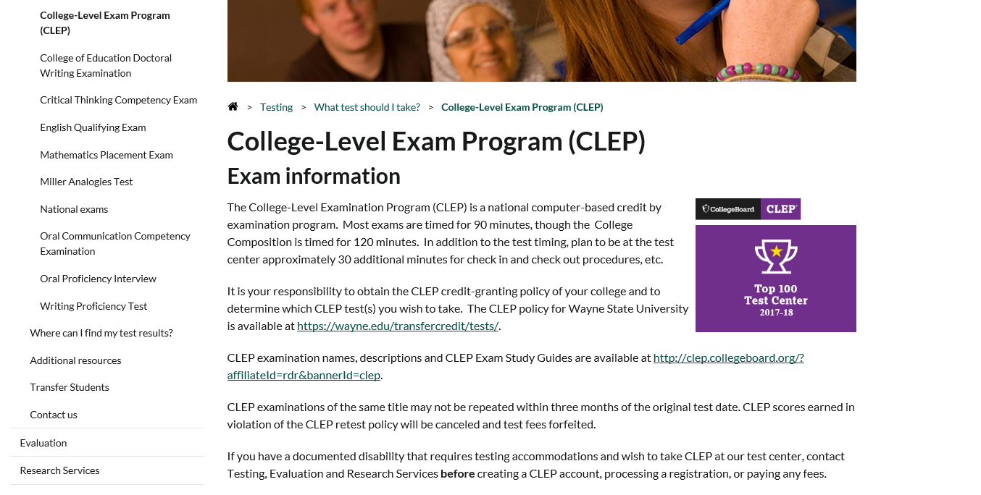
Notes:
National test
The advanced placement test for college students
Earn credit for the course
Very strong national program
This can save you work and money.
The test is $180 compared to the taking the class.
Very recently, WSU changed the rules.
Now we have increased the number of tests you can earn through these exams.
There is no limit now.
Now don’t have to take classes in last 30 credit hours here.

Slide 23
https://wayne.edu/transfercredit/tests/
Notes:
For students who are taking CLEP,
Every school determines which courses they accept CLEP for.
It is your responsibility to determine that you are taking the right test for WSU credit.
https://wayne.edu/transfercredit/tests/

Slide 24
Modern States CLEP Freshman Year for Free
https://modernstates.org/freshman-year-free/
Notes:
A non profit is called freshman year for free
Students can get free study materials and
Test fee waivers

Slide 25
National Testing Companies
Tests we administer
GRE
LSAT
PRAXIS series
TOEFL
Notes:
WE are also a testing company

Slide 26
Questions?
Notes:
Thank you for your attention.
If you have any questions, please contact us.
NCTA test center
You can reach us at testing@wayne.edu
Any Questions

Slide 27
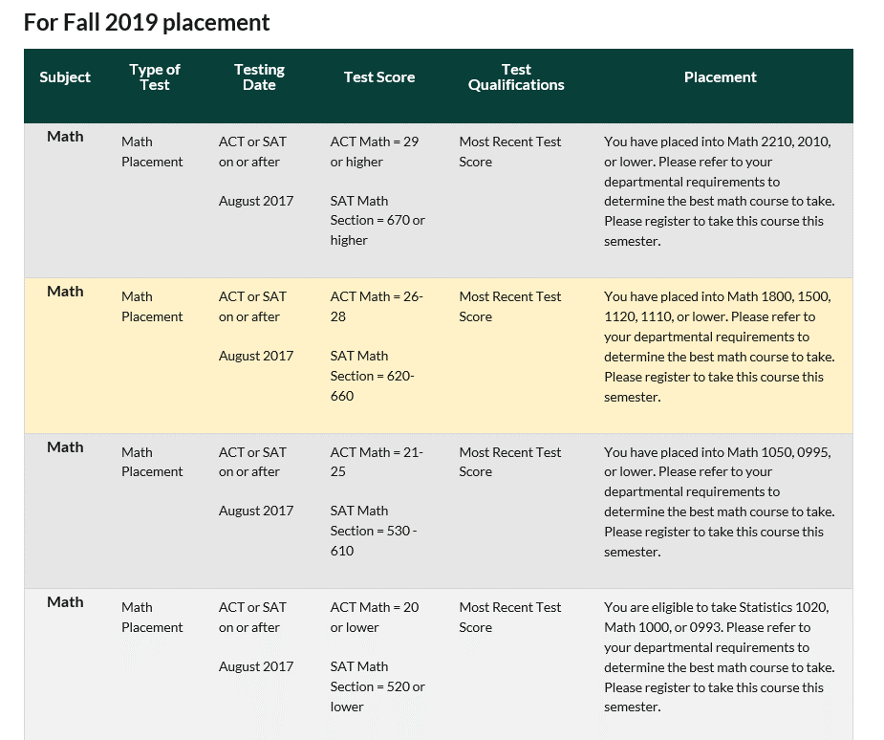

Slide 28
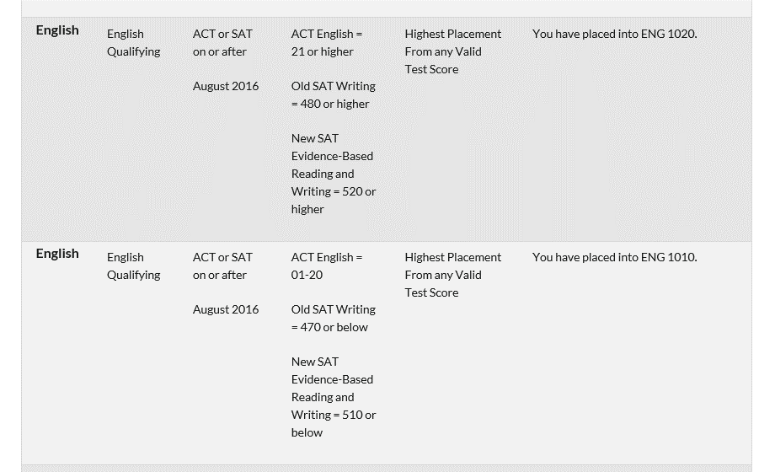

Slide 29
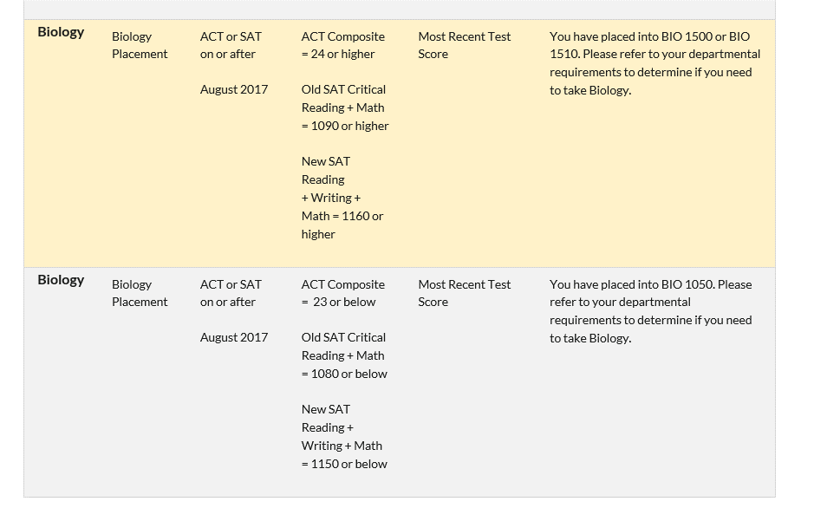

Slide 30
