Slide 1
Revisions to Student Evaluation of Teaching: One Year of Experience
Spannaus, Kernsmith, Casey, Ouellett, Smoller, Brockmeyer, Woodward
Wayne State University
Lilly Conference, 2015, Oxford, Ohio

Slide 2
Background
2N Committee (equal number of administrators & faculty)
Punted from collective bargaining
Resolve contentious issues around Student Evaluation of Teaching

Slide 3
Issues
Perceptions that SET was not valid measure
High stakes
P&T
Annual review
Little use of other measures of teaching
Richer measures are more work
SET is easy and embedded in contract language
Image: Dept of Defense

Slide 4
Former Instrument
24 Likert scale items – public data
3 summative items, used for P&T and annual review
21 instructor feedback/diagnostic items
13 open ended items – confidential data
Demographics, attendance, required/elective
Last revised ca. 1995
Focused on traditional class format

Slide 5
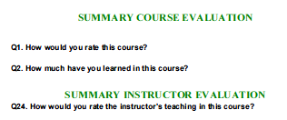
Beauty Contest Items
Summative ratings
High stakes
Likely discriminatory effect

Slide 6
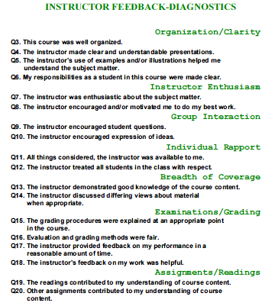
More Useful
Somewhat dated
Not applicable to many classes

Slide 7
Goals
Improve SET response rates
Raise the validity of the SET, especially for a broader range of teaching and learning contexts
Increase the utility of SET for students, faculty and administrators
Improve confidence in the data reported by the SET process

Slide 8
Challenges
Discriminatory effect of summative items vs. high stakes use in P&T and annual reviews
Low response rates for online instruments
Low trust among faculty
Diagnostic items not well suited for online, labs, studio, etc

Slide 9
But Wait, There’s More …
Student government wanted access to SET data
Old SET data were published in hard copy until late 90s
Web publishing is easy and inexpensive
What to publish? How to make it useful?

Slide 10
Steps
Revise instrument
Initiate marketing and education campaign for completion of SET
Publish useful data for students and faculty

Slide 11
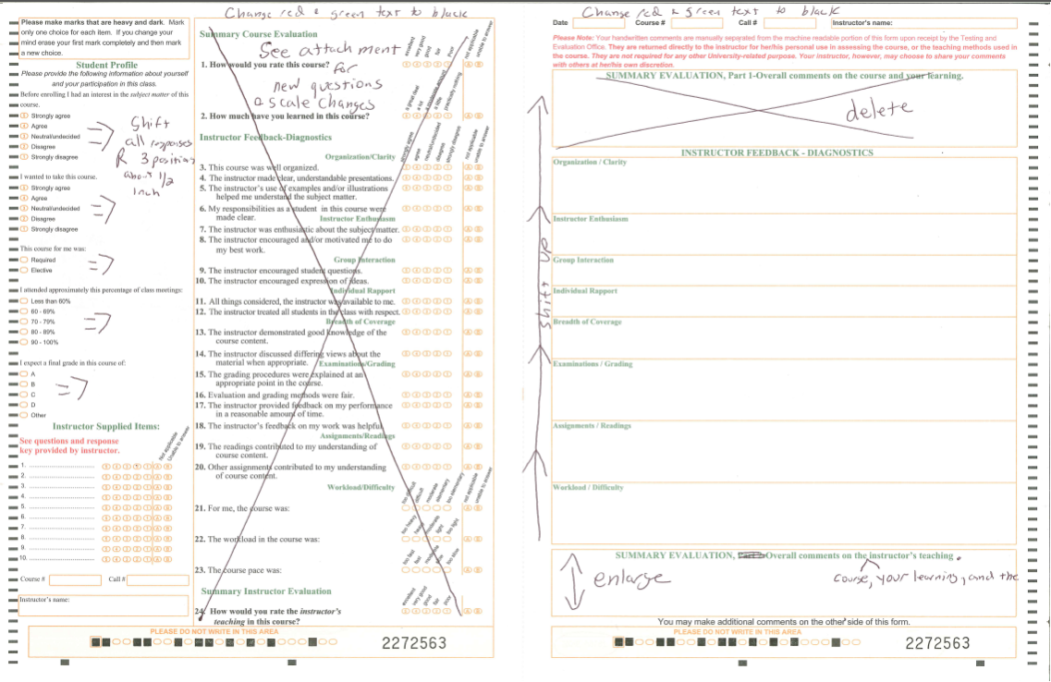
Instrument
Reword diagnostic items to clarify, broaden applicability
Place contentious summative items after diagnostics
Notes:
Doesn’t this slide belong earlier, like after11

Slide 12
Revisions

Slide 13
Marketing

Slide 14
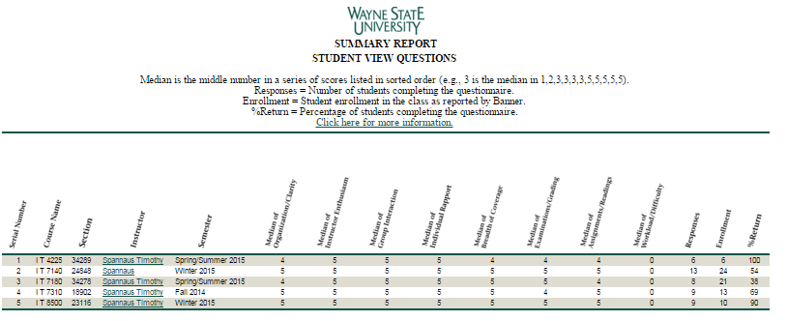
Publication
Available from registration page
Reports Median
Requires authentication

Slide 15
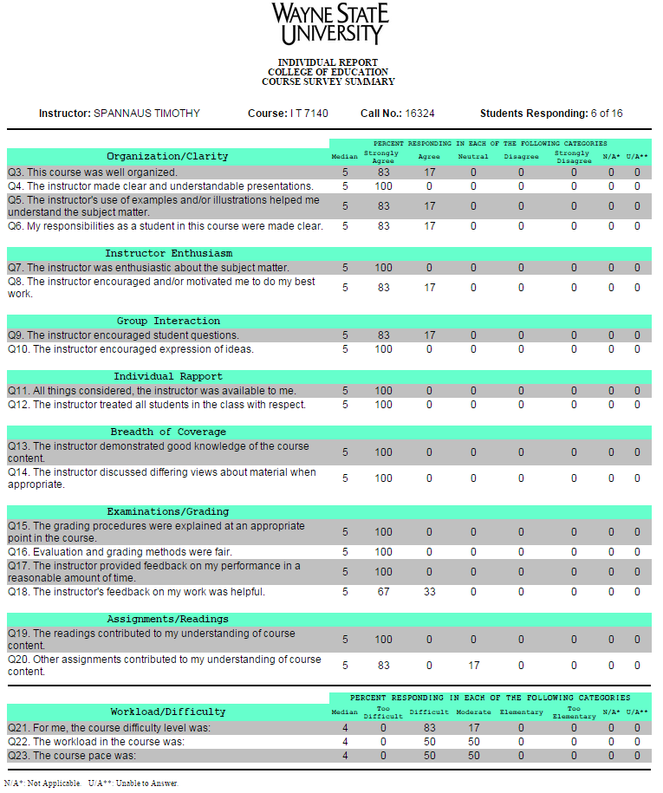
Instructor Detail by Class
Includes diagnostic and workload/difficulty items only

Slide 16
Approvals
AAUP-AFT
Provost
Academic Senate Policy Committee

Slide 17
Response Rates
Some improvement
Semester | Online Form | Paper Form (in class)
W 2014 REMINDERS | 26% | 70%
W 2015 REMINDERS and MEDIA CAMPAIGN | 39% | 70%

Slide 18
A New Issue
Long processing time +
Need for earlier reports =
Earlier deadline: Dec. 2 (Two weeks before finals)
2N Committee caught by surprise
Strong negative reaction from faculty

Slide 19
Now Underway
For students: How to interpret SET data
For faculty: Rationale for new instrument, history of publication of data, how to use data to improve teaching
For SET committee: Examine feedback about use of revised SET, consider further revisions of SET
Notes:
For SET committee: Consider further revisions of SET, examine use and gather feedback about the revised SET, recommend appropriate use of SET in faculty evaluation.

