Slide 1
Improving Student Evaluation of Teaching at an Urban Research University: Many Goals, A Few Directions
Spannaus, Ouellett, Casey, Kernsmith, Smoller, Brockmeyer, Woodward
Wayne State University
Lilly Conference, 2014, Oxford, Ohio

Slide 2
Background
2N Committee (equal number of administrators & faculty)
Punted from collective bargaining
Resolve contentious issues around Student Evaluation of Teaching

Slide 3
Issues
Perceptions that SET was not valid measure
High stakes
P&T
Annual review
Little use of other measures of teaching
Richer measures are more work
SET is easy and embedded in contract language
Image: Dept of Defense

Slide 4
Instrument
24 Likert scale items – public data
3 summative items, used for P&T and annual review
21 instructor feedback/diagnostic items
13 open ended items – confidential data
Demographics, attendance, required/elective
Last revised ca. 1995
Focused on traditional class format

Slide 5
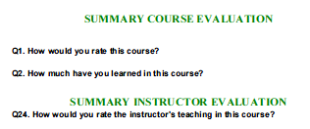
Beauty Contest Items
Summative ratings
High stakes
Likely discriminatory effect

Slide 6
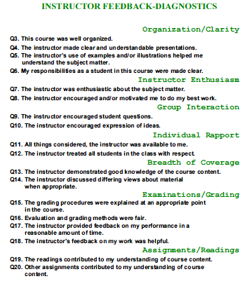
More Useful
Somewhat dated
Not applicable to many classes

Slide 7
Reporting
Summative items (3)
Mean and SD, distribution
Sum of means: 15-point scale
Diagnostic items (21)
Mean, SD, Distribution

Slide 8
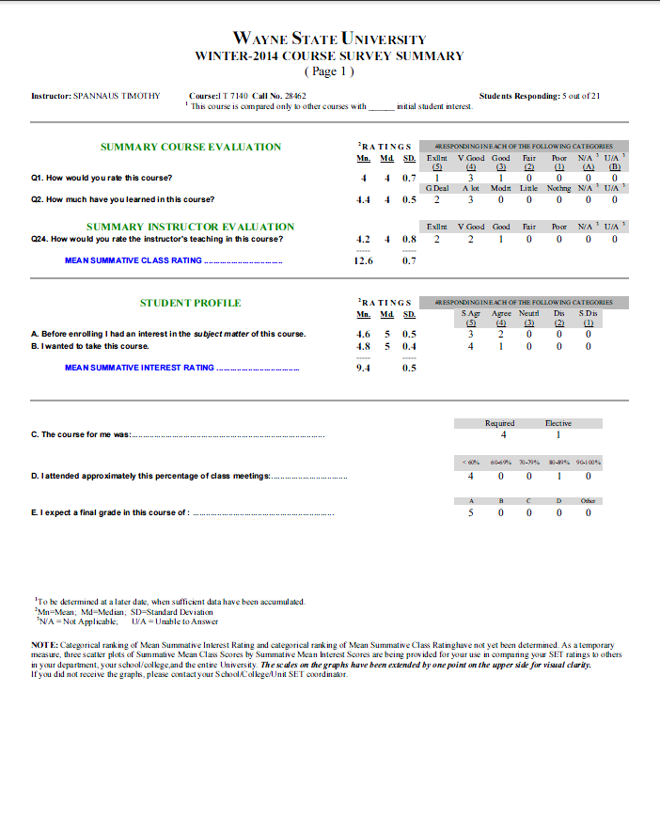
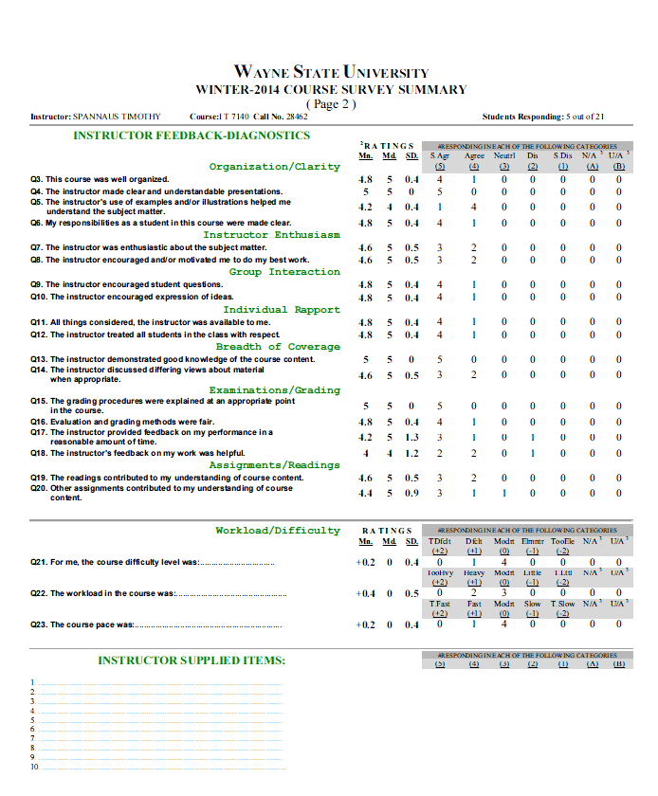
Reporting

Slide 9
Goals
to improve SET response rates
raise the validity of the instrument, especially for a broader range of teaching and learning contexts
increase the utility of SET for students, faculty and administrators
improve confidence in the data reported by the SET process

Slide 10
Challenges
Discriminatory effect of summative items vs. high stakes use in P&T and reviews
Low response rates for online instruments
Low trust among faculty
Diagnostic items not well suited for online, labs, studio, etc

Slide 11
But Wait, There’s More …
Student government desire to publish SET data
Data had been published in hard copy until late 90s
Web publishing is easy and inexpensive
What to publish? How to make it useful?

Slide 12
Steps
Revise instrument
Initiate marketing and education campaign for SET
Publish useful data for students and faculty

Slide 13
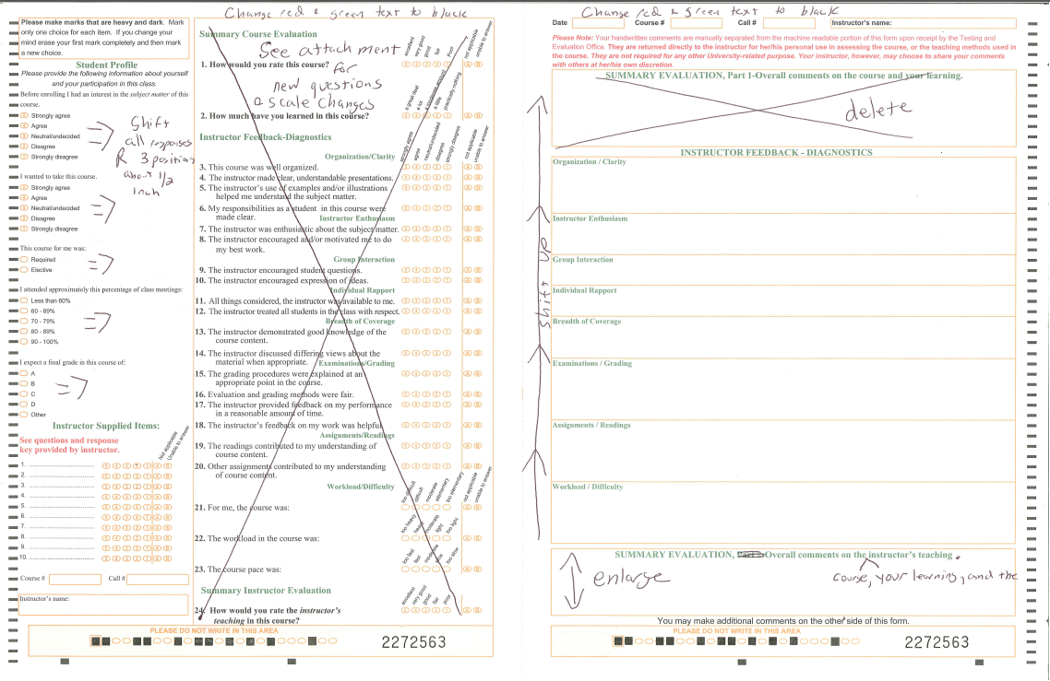
Instrument
Reword diagnostic items to clarify, broaden applicability
Place contentious summative items after diagnostics

Slide 14
Revisions

Slide 15
Marketing

Slide 16
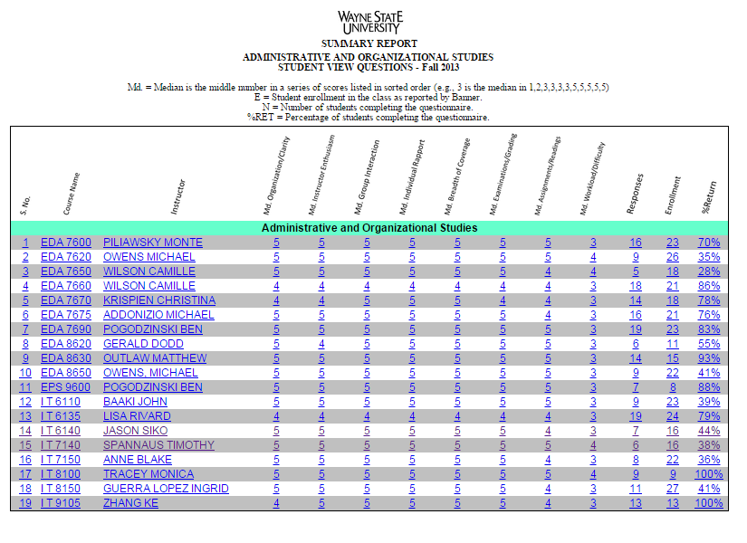
Publication

Slide 17
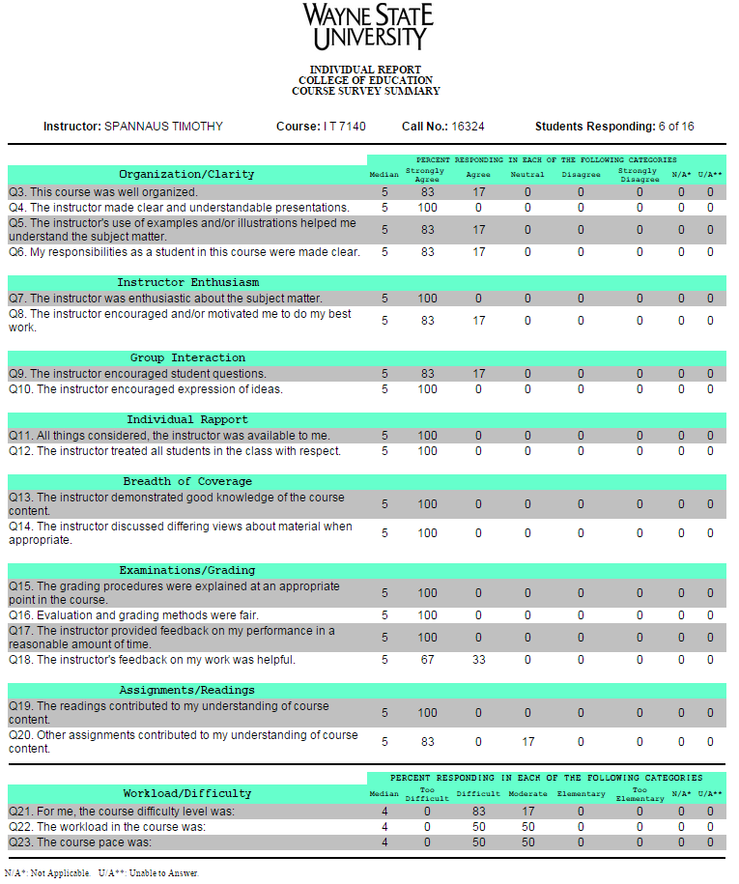
Instructor Detail by Class
Includes diagnostic and workload/difficulty items only

Slide 18
Approvals
AAUP-AFT
Provost
Academic Senate Policy Committee

Slide 19
Coming Soon
For students: How to interpret SET data
For faculty: Rationale for new instrument, history of publication of data, how to use data to improve teaching

